Slide 1
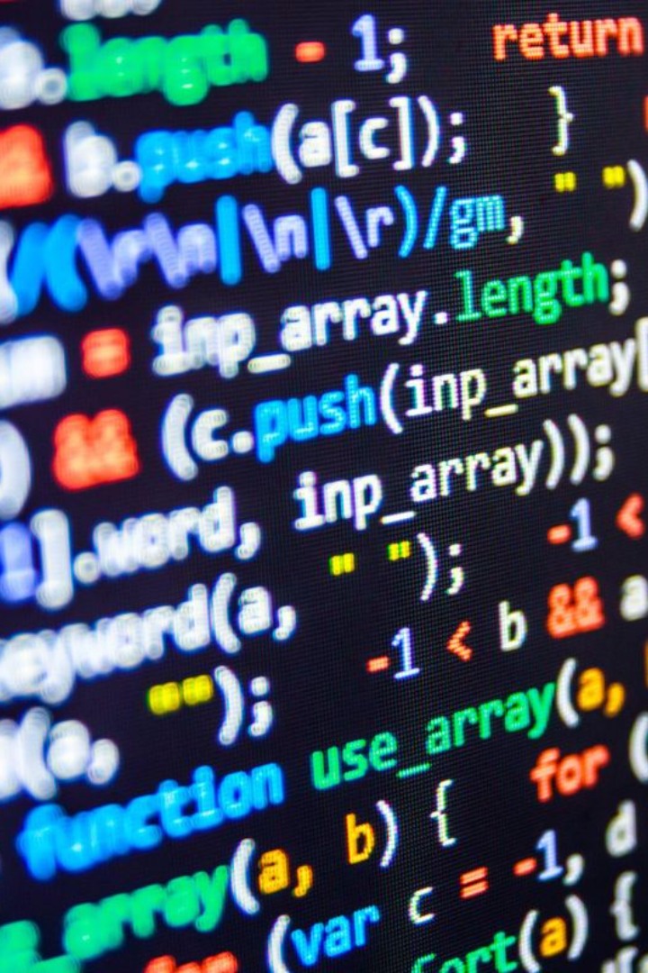
C Language simple Program and Its Explanation
Welcome to the world of C programming! In this presentation, we will explore the fundamentals of C language and dissect our first program, the Hello World program, line by line.

Slide 2
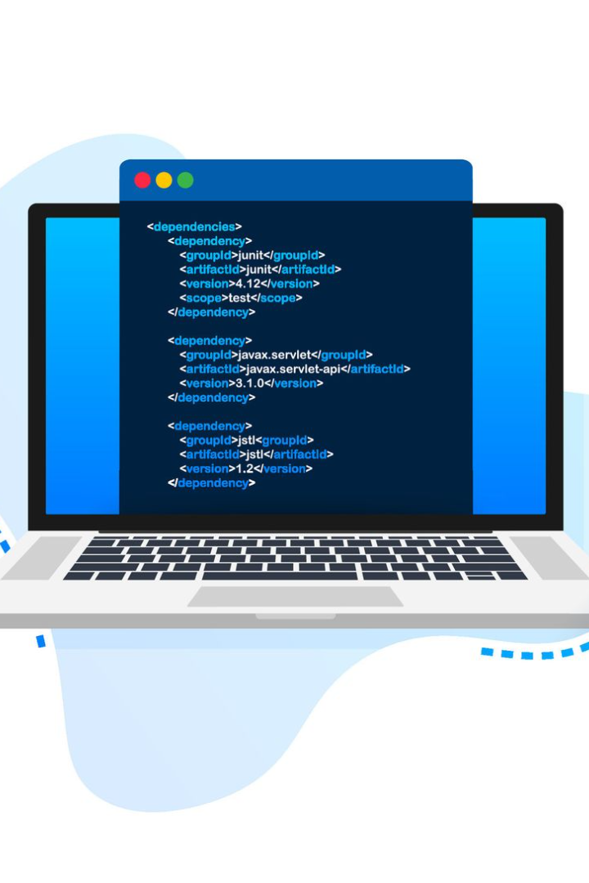
Your First C Program
Let's dive into the world of programming by creating our first C program. Get ready to write your first "Hello World" program with the help of a compiler!

Slide 3

Understanding Line by Line
1
Line 1
The program starts with the preprocessor directive, which includes a standard input/output header file called "stdio.h".
2
Line 3
The int main() function is the starting point of every C program. It contains the code that will be executed when the program runs.
3
Line 5
The printf() function is used to print the text within the double quotation marks to the console.

Slide 4
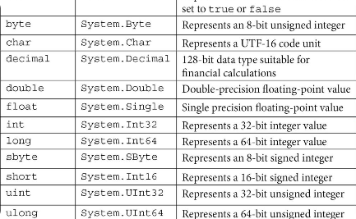
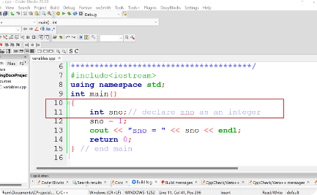
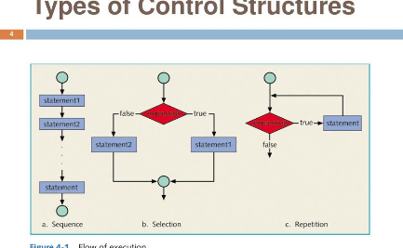
Data Types
Variables
Control Structures
C provides various data types such as int, float, and char to store different types of values.
Variables are used to store and manipulate data in a C program. They must be declared before use.
Control structures like if-else statements and loops are used to control the flow of execution in a C program.
Fundamental Concepts
Before we move forward, let's take a quick look at some fundamental concepts in C programming, such as data types, variables, and control structures.

Slide 5

Debugging Made Easier
Print Statements 🖨️
Compiler Warnings ⚠️
By strategically placing print statements in your code, you can track the values of variables and identify any errors.
Take advantage of compiler warnings to catch potential mistakes before they cause issues in your program.
Step-by-Step Execution 🐞
Use the debugger to step through your code line by line and analyze the values of your variables at each point.

Slide 6
Ready for a Challenge?
Are you eager to apply your newly acquired C skills? Join our coding challenge and put your programming knowledge to the test! Are you up for it?
> Write a code to print your full name.

Slide 7

Conclusion
Congratulations on completing this first C program! We hope you now have a solid understanding of the basics and feel inspired to explore the limitless possibilities of C!

